Slide 1
Spring 2020 A4.2
Group 11

Slide 2
Actors
Moderator —Each show or movie has its own landing page and community called a Channel. Moderators of a Channel are each appointed for a specific language and are responsible for taking care of subtitling in their language by recruiting and managing subtitlers, editing, and overseeing the quality of subtitles in their language
User — User is people who using this website. They can join and unsubscribe group, search movies and watch movie trailers, and write and access movie reviews.
Data Server - the database that store all the information.

Slide 3
Use Cases - Group Moderator
Moderator create watcher’s group
Moderator invite other people to join the group
Moderator populate the movie list
Moderator pull movie list from a movie list server
Moderator create a movie watching event
Moderator open or close a voting period

Slide 4
Use Cases - People or Website User
People join the group
People unsubscribe the watcher’s group
People search and browse the movie
People watch the movie trailer
People access the movie review from a movie review server
People vote for watching that movie or not

Slide 5
Use Case ID: USR01
Use Case Title: Create A Group
Actors: Moderator, Data Server
Use Case Description: Moderator create a watching group and system store the group information to data server.
Preconditions:
The moderator must be logged in.
Postconditions:
A watcher group exist in the system.
Steps:
The moderator click create a group button.
The system display create view and request moderator to enter information.
The moderator enter a unique group name and a group description.
The system verify the group name. [Exception - Name already exist]
The moderator click confirm button.
The system save the group information and send to data server for further use.

Slide 6
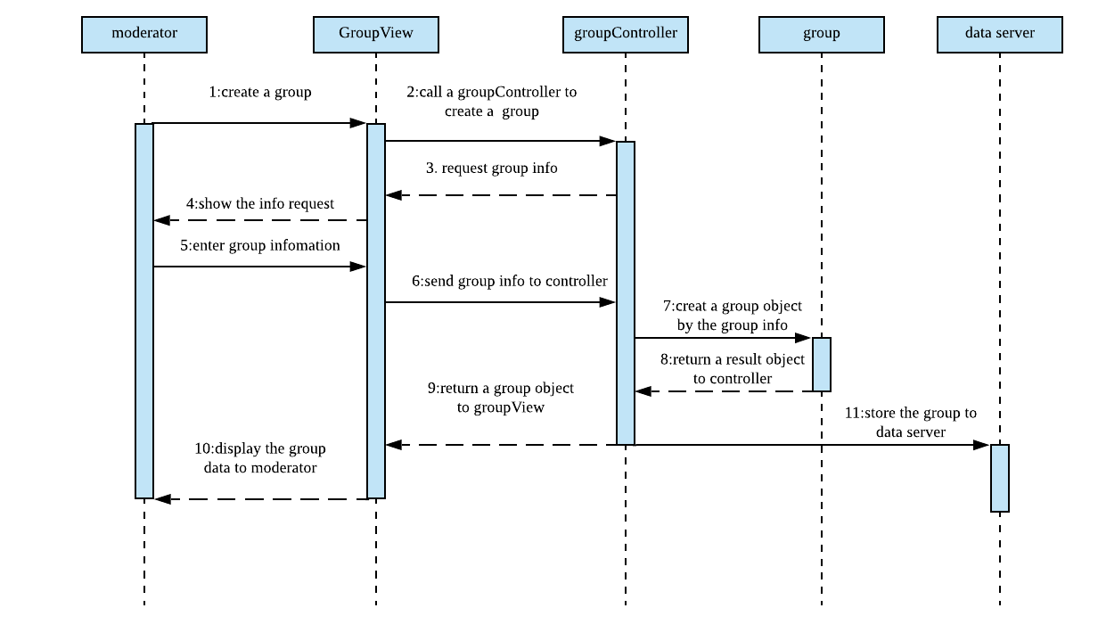
USR01/Sequence diagram

Slide 7
Use Case ID: USR02
Use Case Title: Invite Into Group
Actors: Moderator
Use Case Description: Moderator invite people to join in group by sending email.
Preconditions:
A group is exist in the system.
Must be a moderator.
The person who been invited must be exist.
Postconditions:
System will send an invite message to that person
Steps:
The moderator click invite button.
The system display invite view and request user’ email address.
The moderator enter the email address.
The system verify the email address. [Exception: email not valid]
The moderator click confirm button.
The system send an invitation email to that email address.

Slide 8
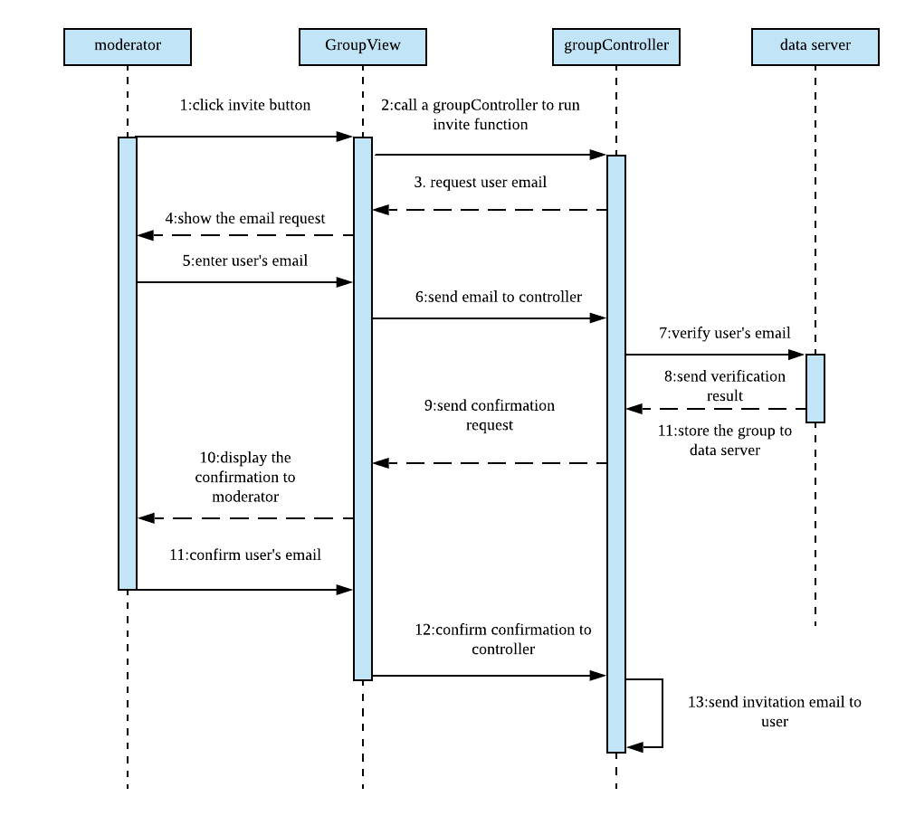
USR02/Sequence
diagram

Slide 9
Use Case ID: USR03
Use Case Title: Populate A Potential Movie list
Actors: Moderator, Data Server
Use Case Description: Moderator populate a movie list by adding movie name, trailer link, and review link and store that movie list in that group.
Preconditions:
A group is exist in the system.
Must be a moderator.
Postconditions:
System stores the movie list information in that group

Slide 10
Use Case ID: USR03
Steps:
The moderator click populate button.
The system display movie list edit view.
The moderator click add movie button.
The system display movie information view and request moderator input movie name, trailer link, and review link.
The moderator enter the movie information and click save button.
The system close movie information view.
The moderator click confirm button.
The system save the movie list and send information to data server and save it.
Generalization: 3a. The moderator click pull a movie list.

Slide 11
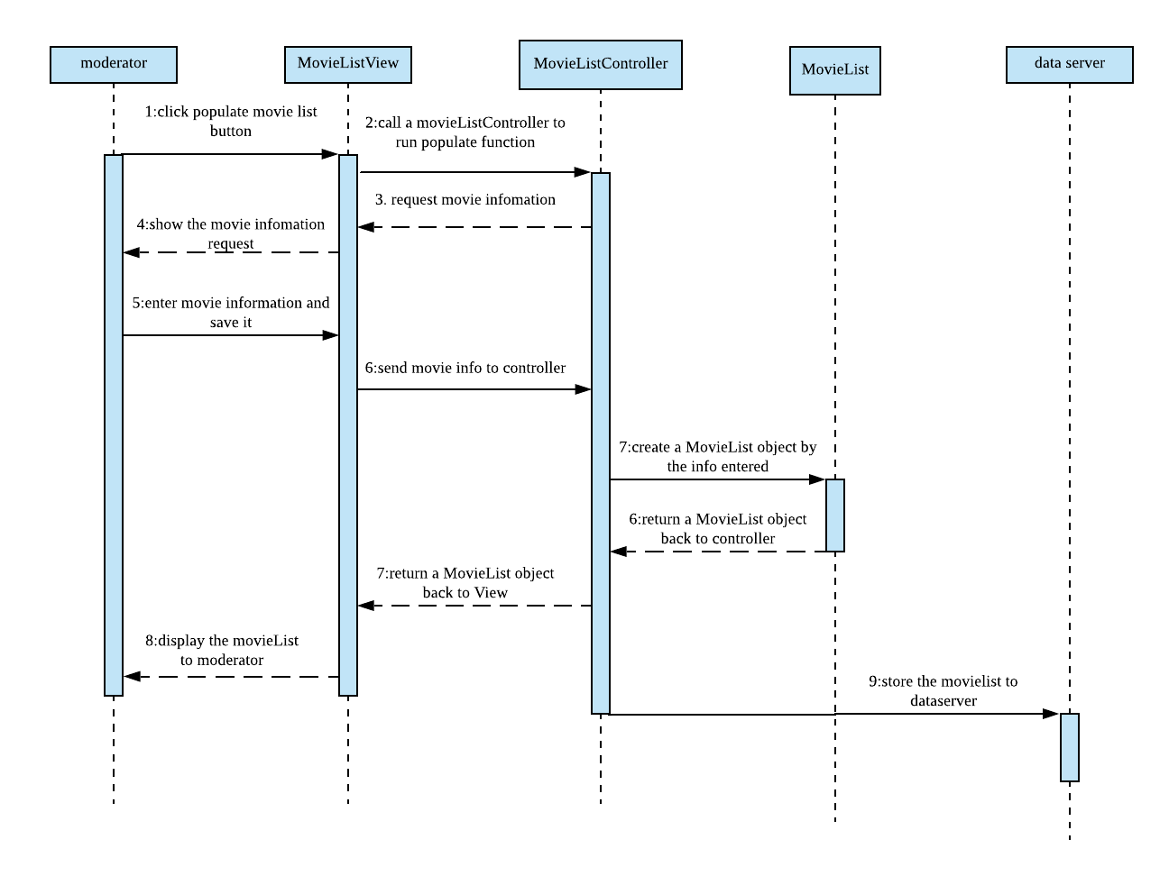
USR03/
Sequence
diagram

Slide 12
Use Case ID: USR04
Use Case Title: Pull A Movie List
Actors: Moderator, Data Server
Use Case Description: This use case describe how a Moderator pull a movie list from Server
Preconditions: A group is exist in the system. A movie list has been populated. The movie list server is connected.
Postconditions: System stores the movie list information in that group
Steps:
moderator click pull a movie list;
System will request a movie list from Movie List server, which contains the name of the movie and the link of review and trailer;
moderator can edit his own movie list by adding movies from the pulled list or delete the existed movie from his own one;

Slide 13
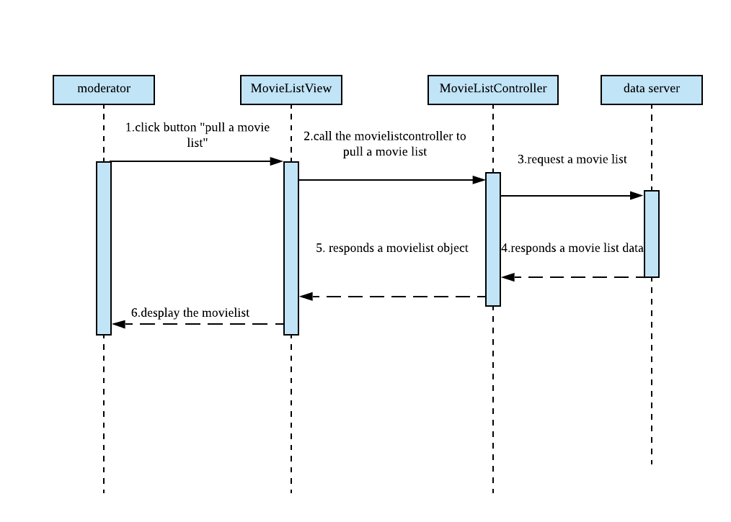
USR04: Sequence diagram

Slide 14
Use Case ID: USR05
Use Case Title: Create A Watching Event
Actors: Moderator
Use Case Description: Moderator can create a watching event for a group on a certain day. The server will receive the request and notice everyone in this group.
Preconditions: A group is exist in the system.
Postconditions: System will send a message to every people in that group
Steps:
Moderator select the group
click create a watching event
System will open a vote create window
The system will create this event for the group and notice all the members in this group;

Slide 15
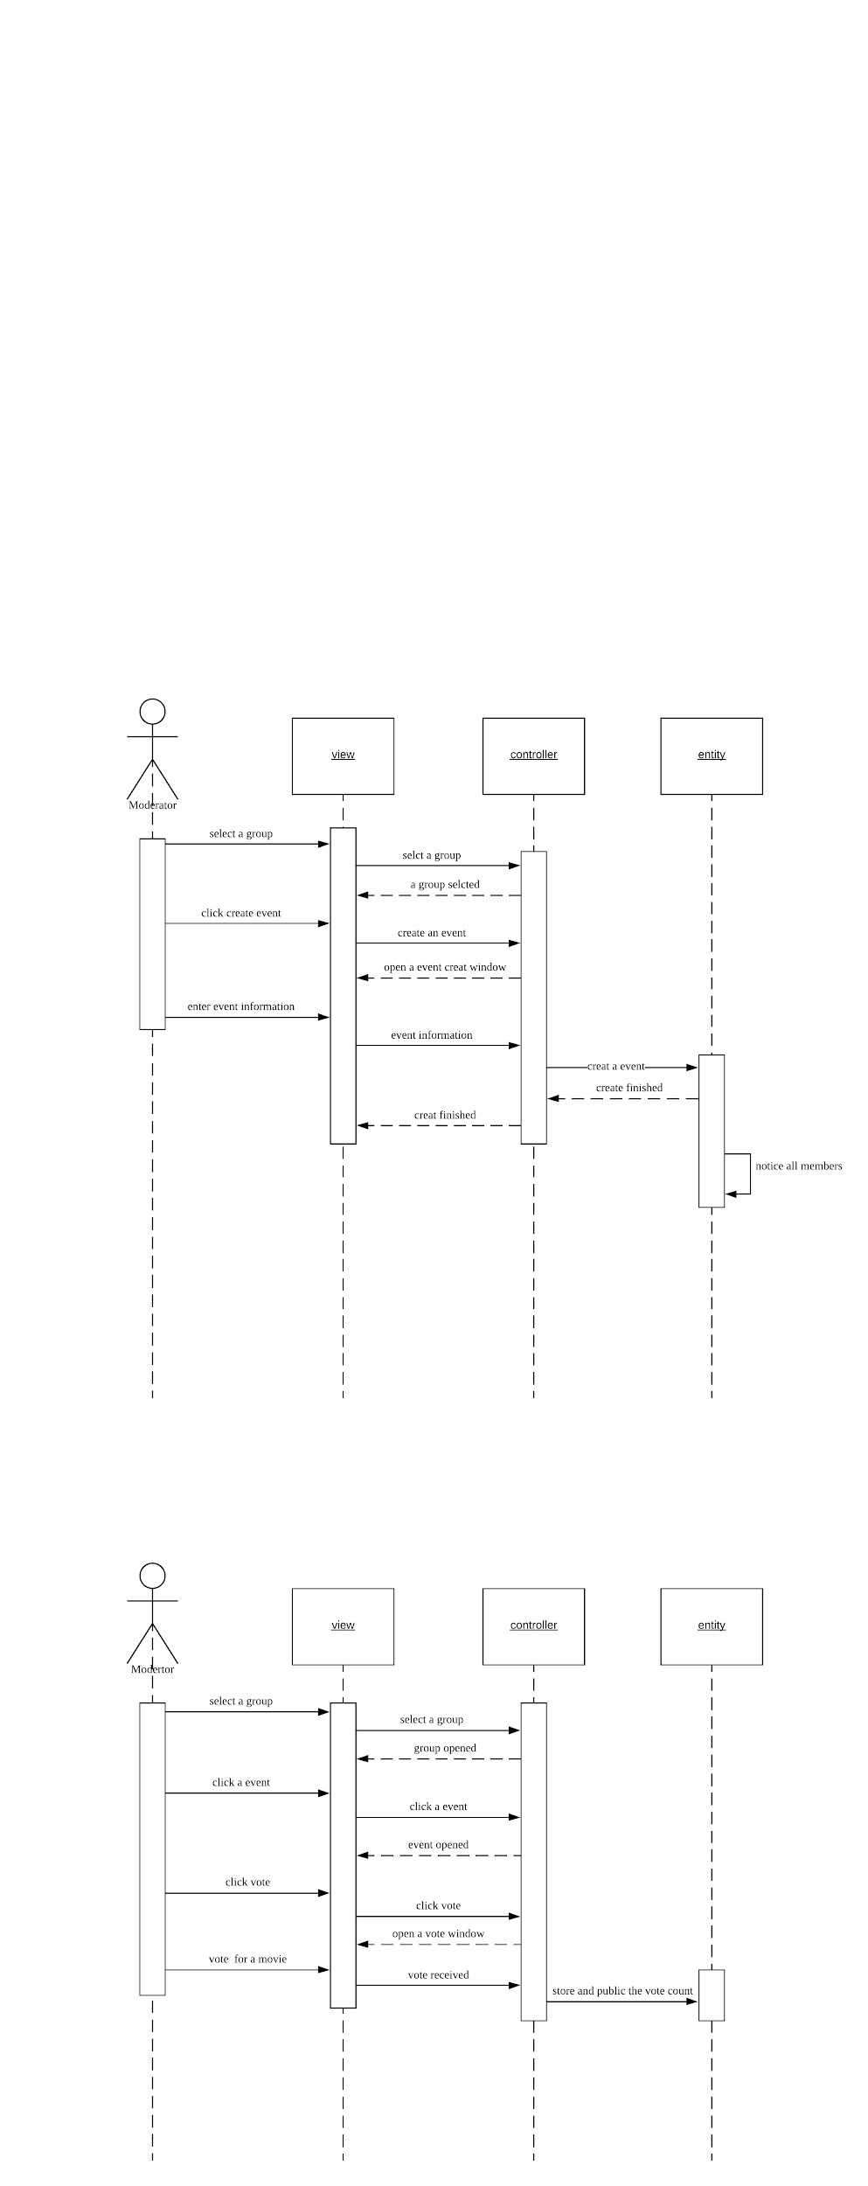
USR05: Sequence diagram

Slide 16
Use Case ID: USR06
Use Case Title: Change Vote Period
Actors: Moderator
Use Case Description: Moderator could change vote period during creating watching event.
Preconditions: A group is exist in the system. A watching event is creating;
Postconditions: System will send a message to every people in that group, and the vote will be open.
Steps:
When a event has been created, system will open the window for the moderator;
Moderator could enter the open date and the close date;
System will create the vote period and notice all the members.

Slide 17
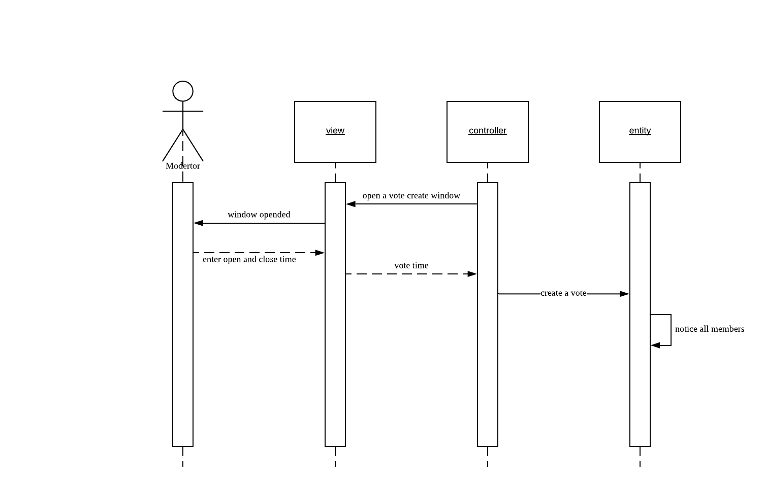
USR06: Sequence diagram

Slide 18
Use Case ID: USR07
Use Case Title: Join In A Group
Actors: User, Data server
Use Case Description: This use case describe how a user join a group when receive an invitation
Preconditions: A group is exist in the system, receive a invitation.
Postconditions: System store that person information in that group.
Steps:
User decided join the group or not;
If the user do not want to join, he only need ignore this email;
If the user want to join the group, he need click the link in the invitation email;
Then the system will store the user date to the group information to add this user to the group as a member;

Slide 19
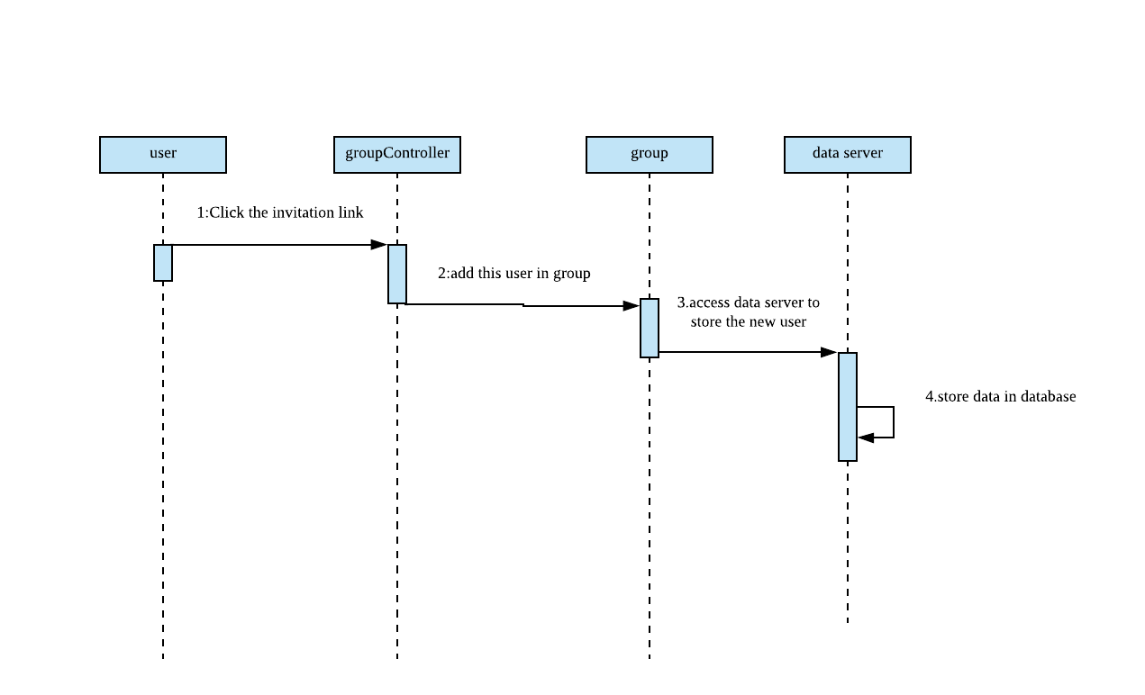
USR07: Sequence diagram

Slide 20
Use Case ID: USR08
Use Case Title: Unsubscribe A Group
Actors: User, Moderator, Data Server
Use Case Description: This use case starts when user and moderator do not want to be part of group. User or moderator unsubscribe a group. Then system remove the user information from that group and if moderator unsubscribe the group, the system remove the whole group.
Preconditions: A group is exist in the system. Member or moderator is in that group.
Postconditions: System remove the member information from that group.
Steps:
User or moderator click button of unsubscribe a group. Sending the request of subscribe a group to system.
System receive the request of unsubscribe a group.
System remove the user from that group. And if it’s moderator, system will delete whole group.
Data server delete information about user in this group. If it’s moderator, data server will delete group information.
User or moderator unsubscribe a group successfully.

Slide 21
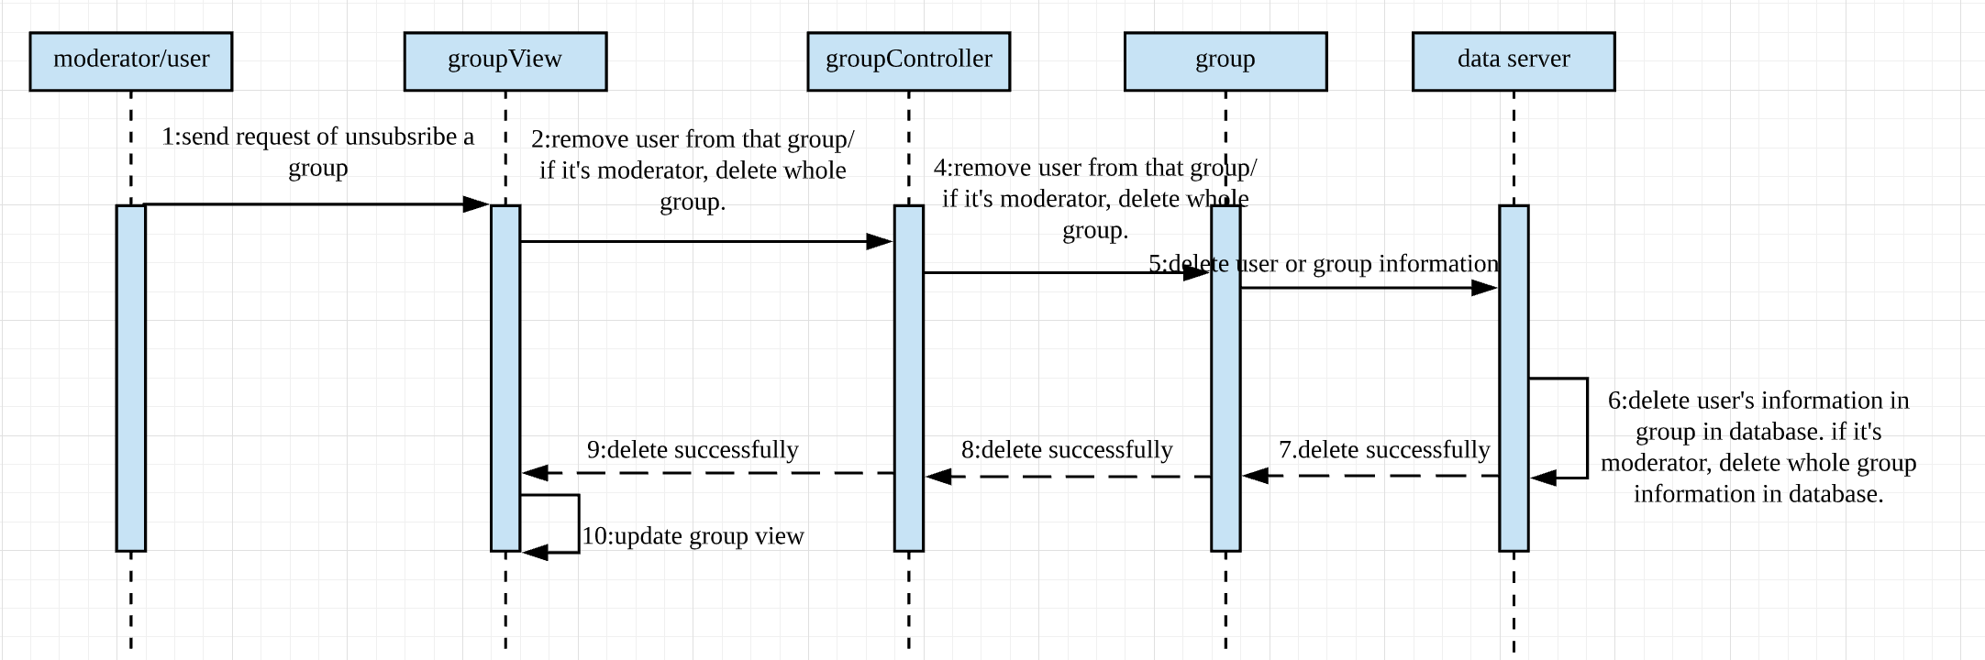
USR08/Sequence diagram

Slide 22
Use Case ID: USR09
Use Case Title: Access The Movie Review
Actors: User
Use Case Description: This use case starts when members click the link of movie review. It will jump to movie review page.
Preconditions: The user is in a group.
Postconditions: Jump to movie review page.
Steps:
1.User click link of movie review.
2.It will jump to movie review page.
3.User can start movie review.

Slide 23
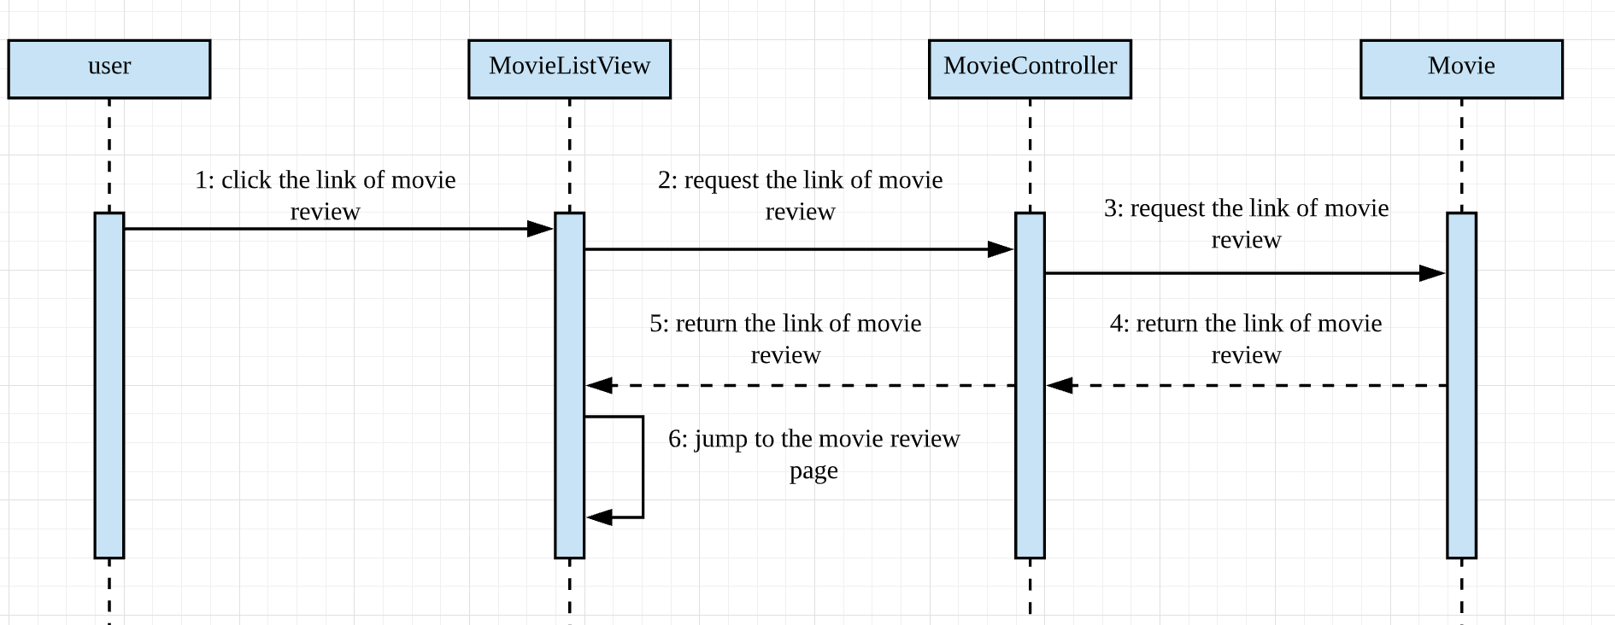
USR09/Sequence diagram

Slide 24
Use Case ID: USR10
Use Case Title: Search And Browse The Movie
Actors: User
Use Case Description: User clicks movie list and login in movie list page. Then, user can enter keywords in search bar at movie list page. Finally, the screen will show all results related to keywords
Preconditions: User in a group.
Postconditions: System show results to user
Steps:
1.User clicks movie list button.
2.User enter keywords in search bar.
3.Screen will show results related to keywords.

Slide 25
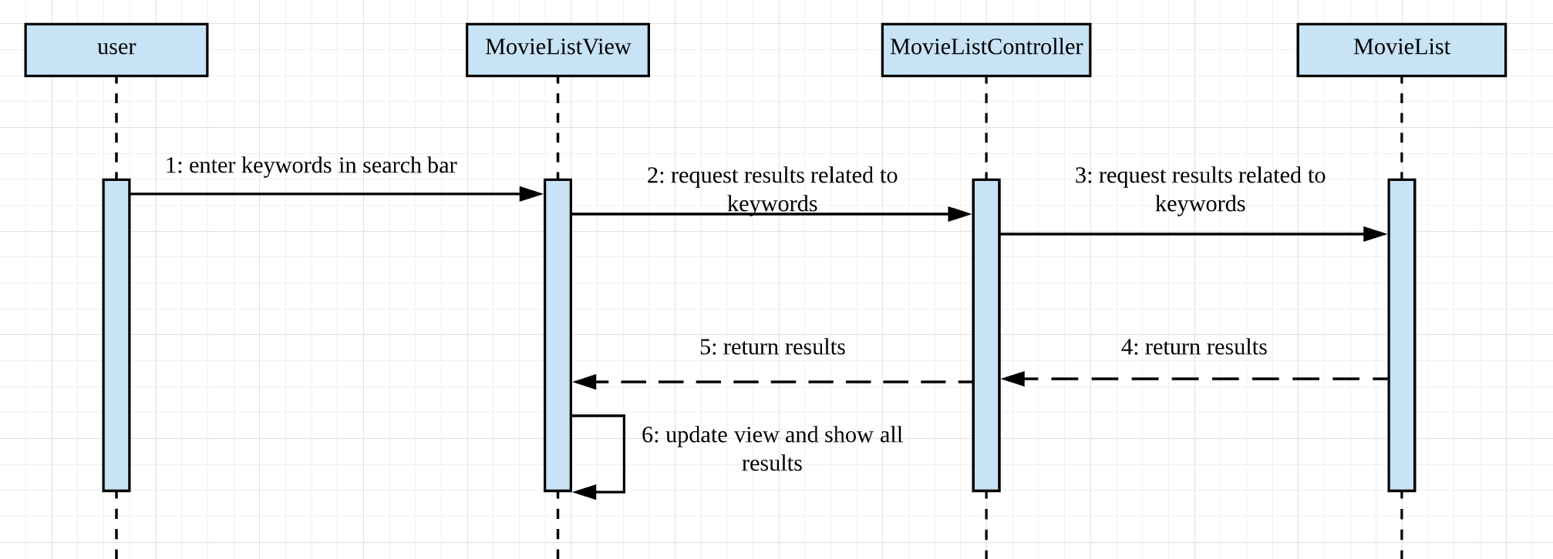
USR10/Sequence diagram

Slide 26
Use Case ID: USR11
Use Case Title: Watch The Movie Trailer
Actors: User
Use Case Description: member click the movie trailer populated by moderator, then the member can watch the video.
Preconditions: The member is in a group. The movie has been added to the movie list by moderator. System already load all data of this movie (name, trailer li nk);
Postconditions: System will send the link of trailer to that member.
Steps:
User select the group he joined in;
User select a movie list;
User select a movie;
User click the link, and Browser will open website by this link and user can watch the trailer from this website.

Slide 27
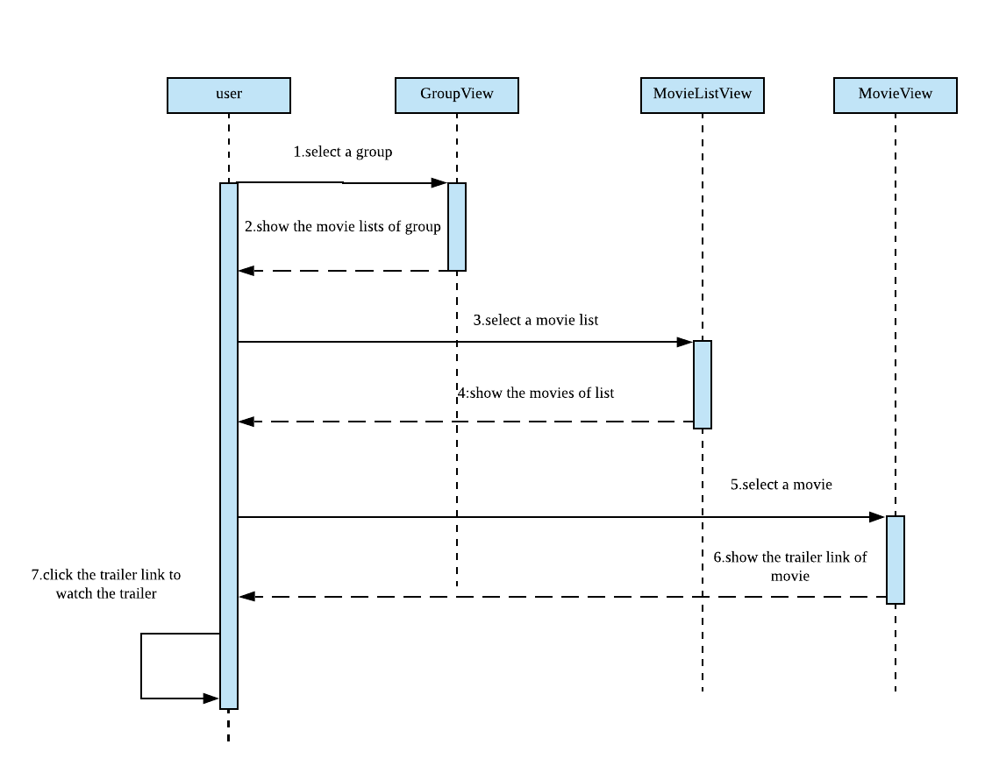
USR11/ Sequence diagram

Slide 28
Use Case ID: USR12
Use Case Title: Vote A Movie
Actors: User, Data Server
Use Case Description: When a vote is open, every member in the group can vote for one movie.
Preconditions: The member is in a group. A watching event is created by moderator. A vote is opened by moderator.
Postconditions: System store and public the vote count for that movie.
Steps:
Member select the group
Member click the event
Member could search and browse the movie
Member vote for one movie
System will store the vote and public the vote count.

Slide 29
USR12/ Sequence diagram

Slide 30
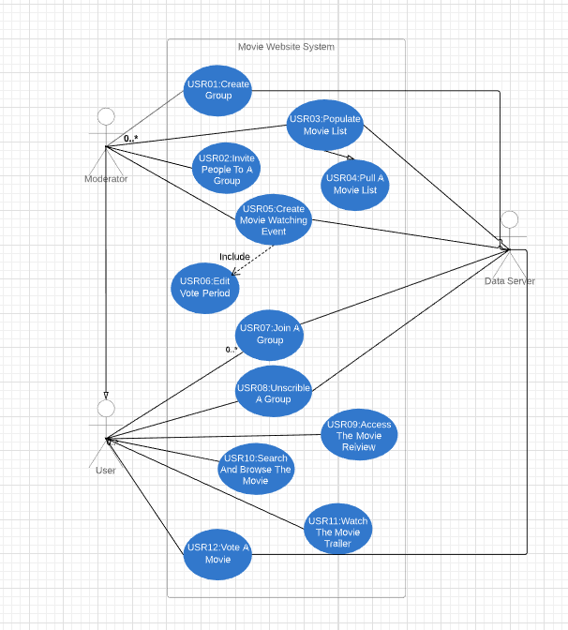

Slide 31
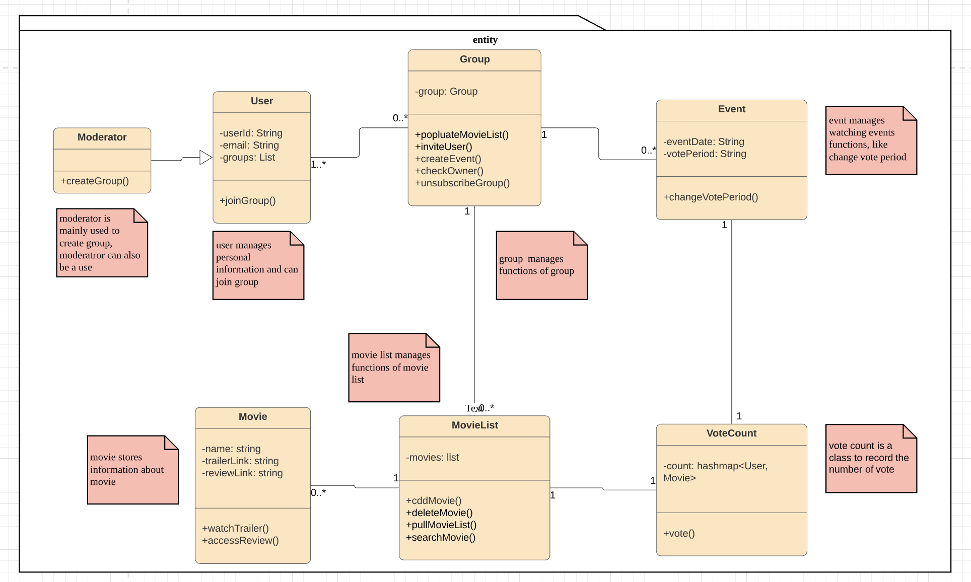
MVC packages-entity

Slide 32
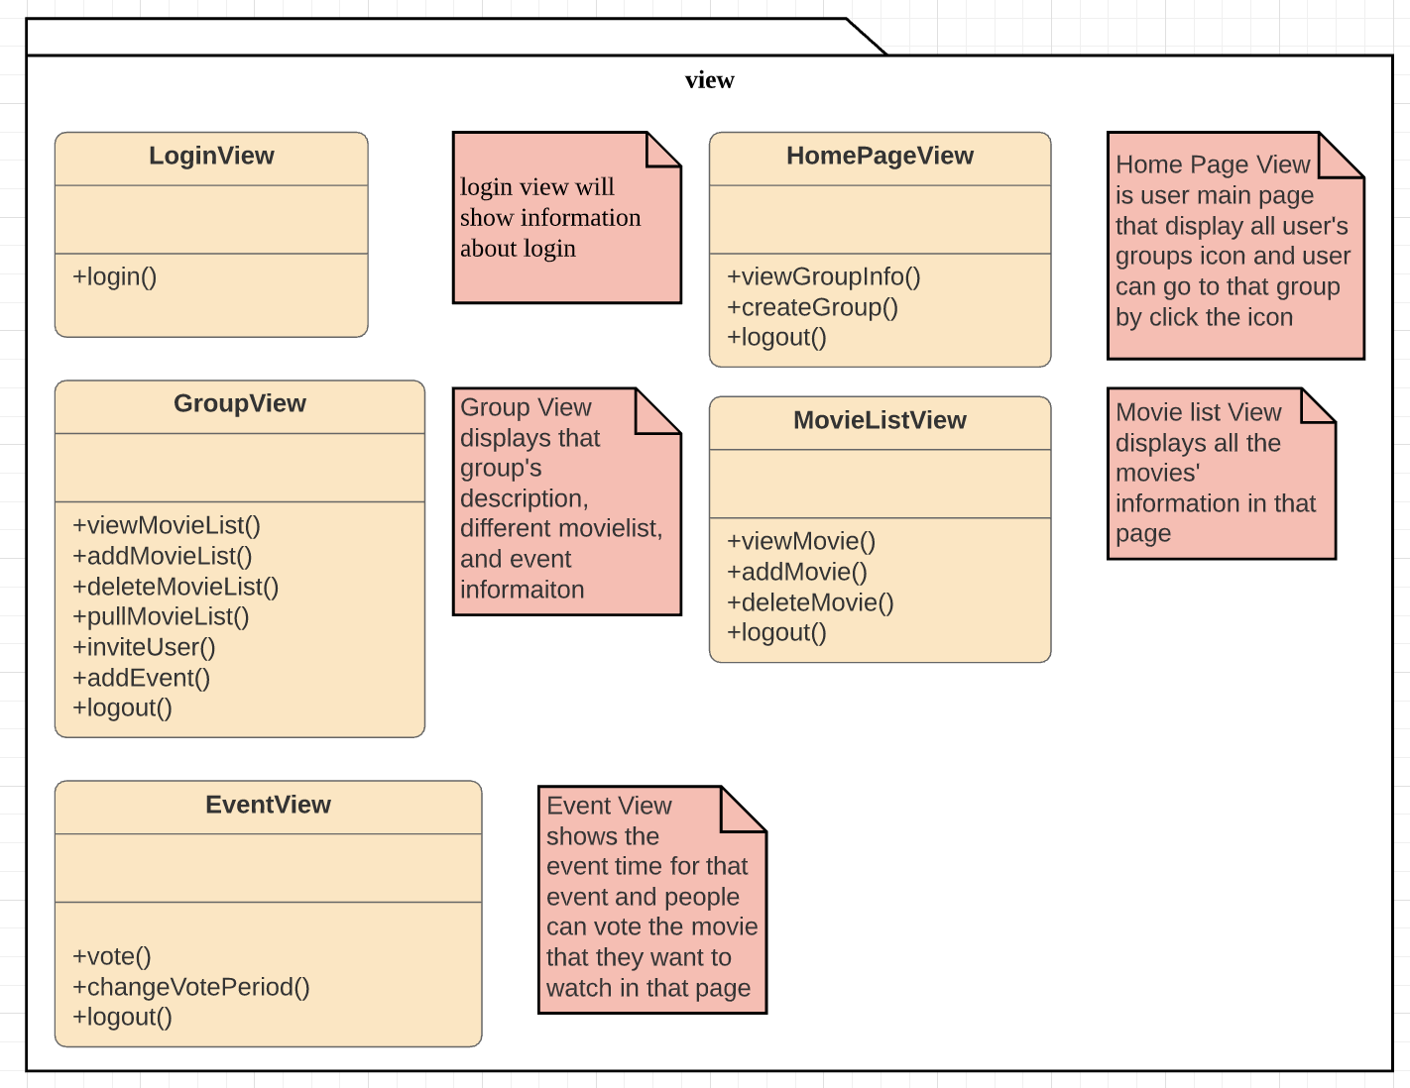
MVC packages-View

Slide 33
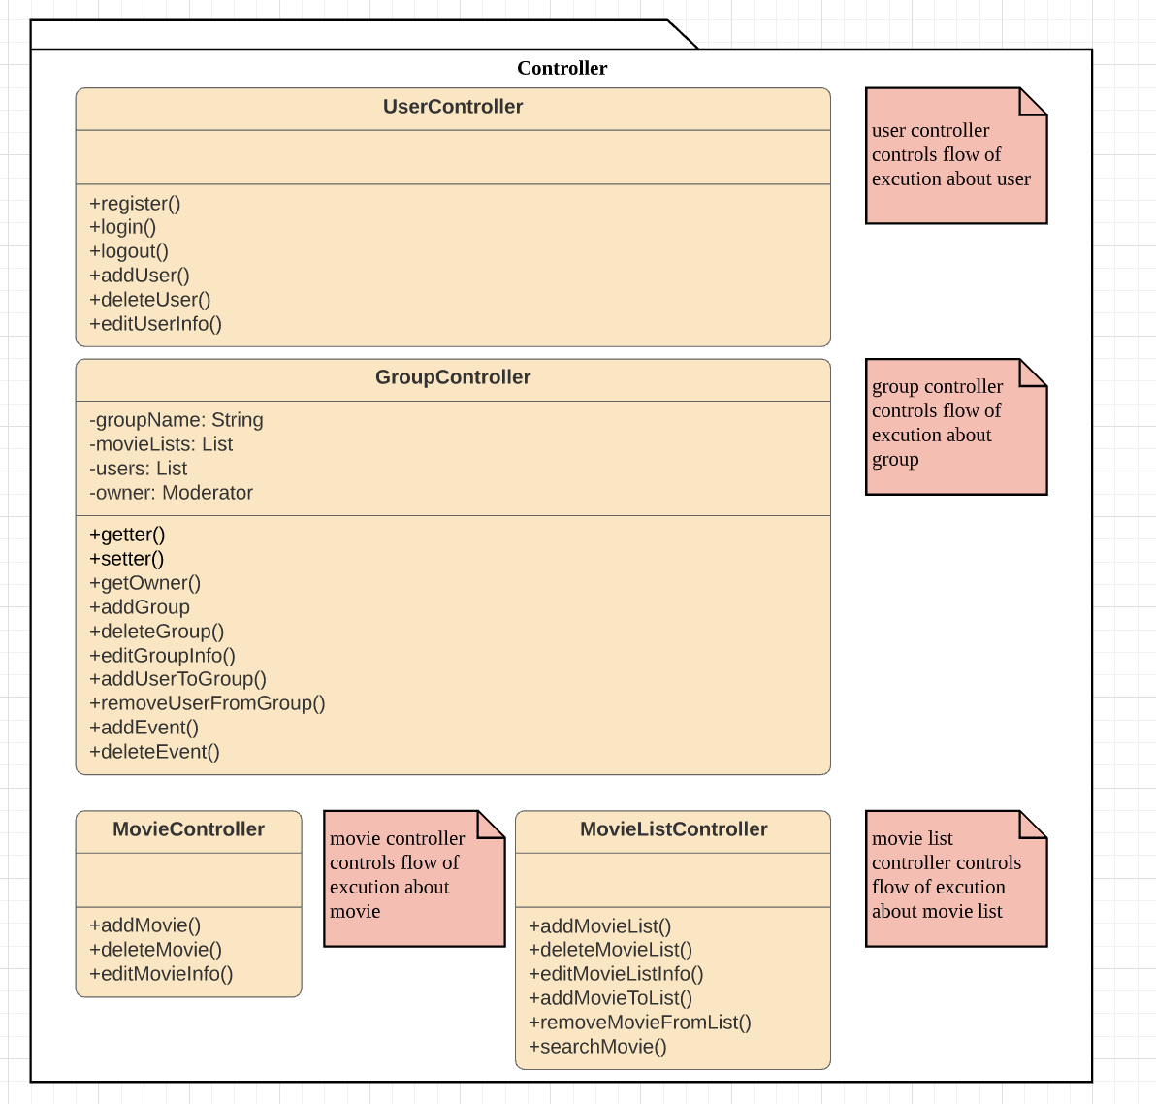
MVC packages-Controller

Slide 34
Features list
1. The system shall allow a group moderator to create a movie watcher’s group
2. The system shall allow the moderator to invite family and friends to join the group
3. The system shall allow friends and family to join a group of movie watchers
4. The system shall allow people to unsubscribe from movie watcher’s groups
5. The system shall allow the moderator to populate movie watcher’s groups with a list of potential movies that could be watched
6. The system shall allow the moderator to pull a movie list from a movie list server/API
7. The system shall allow group members to search and browse the movies that have been populated by the moderator.
8. The system shall allow group member to watch the trailer of the movies that have been populated by the moderator (Obs. Movie trailer do not need to be uploaded by the moderator, however, links to movie trailers must be available along the list of movies that have been populated by the moderator)

Slide 35
Features list
9. The system shall allow group members to have access to movie reviews of the movies that have been populated by the moderator (Obs. Movie reviews do not need to be uploaded by the moderator, however, links to movie reviews must be available along the list of movies that have been populated by the moderator. The system could provide movie reviews from a movie review service)
10. The system shall allow the moderator to create a movie watching event that will occur in the specified date and time defined by the moderator
11. The system shall allow the moderator to open and close a voting period for a specific movie watching event
12. The system shall allow participants of a movie watcher group to be notified that a movie watching event was created and that they can vote for the movies that they want (or do not want) watch in this movie watching event
13. The system shall allow group participants to cast their votes where they indicate what movies they want and do not want to watch in a specific movie watching event previously created by the moderator

Slide 36
Features list
14. The system shall keep the history of movie watching events, votes, and winners for each movie watching group. This information shall only be available for the participants of the movie watching group. I.e., a group, A, cannot see the movie watching events, votes, and winners of another group, e.g., group B.
15. The system shall elect a single movie winner for a movie watching event based on the votes casted by the movie watcher group.
16. The system shall not allow participants of a movie watching group to change their votes AFTER the system computed the winner movie based on casted votes

Slide 37
Bi-directional traceability matrix between the required features and the use cases
requirement features ID | 1 | 2 | 3 | 4 | 5 | 6 | 7 | 8 | 9 | 10 | 11 | 12 | 13 | 14 | 15 | 16
use case ID
USR01 | x
USR02 |  | x
USR03 |  |  |  |  | x
USR04 |  |  |  |  |  | x
USR05 |  |  |  |  |  |  |  |  |  | x
USR06 |  |  |  |  |  |  |  |  |  |  | x |  |  |  | x | x
USR07 |  |  | x
USR08 |  |  |  | x
USR09 |  |  |  |  |  |  | x
USR10 |  |  |  |  |  |  |  | x
USR11 |  |  |  |  |  |  |  |  | x
USR12 |  |  |  |  |  |  |  |  |  |  |  | x | x | x | x

Slide 38
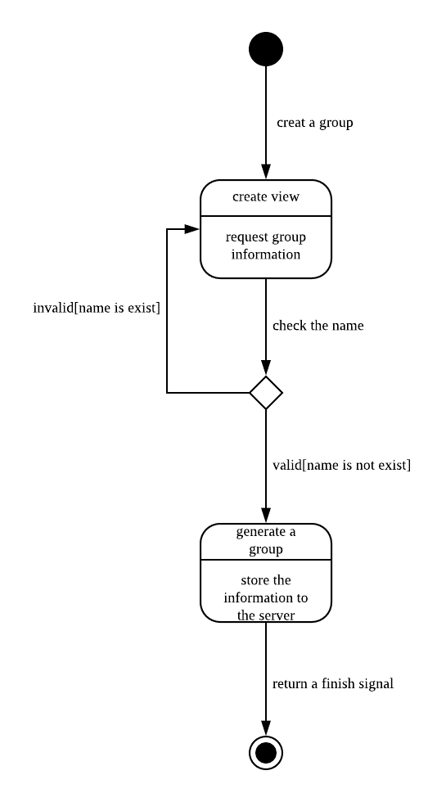
State diagram
(create a group)

